Slide 1
Lecture: 3 Constructor & Destructor Prepared By: Sumaiya Binte Shahid Lecturer Department of CSE, BUBT

Slide 2
What is Constructor?
A constructor in C++ is a special member function (method) that is automatically called when an object of a class is created.

Slide 3
Properties of Constructor
Constructors have the same name as the class.
Constructors don’t have return type as it does not return any value, not even void.
If we do not specify a constructor, C++ compiler generates a default constructor for us.
Constructors are used to initialize all class data members.
There are 3 types of constructors:
(i) Default constructors
(ii) Parametrized constructors
(iii) Copy constructors

Slide 4
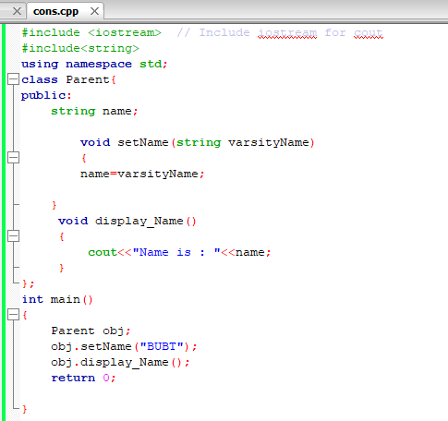
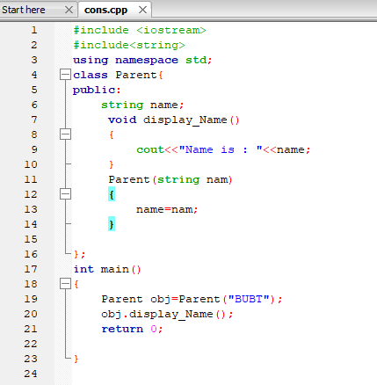
Example of Constructors

Slide 5
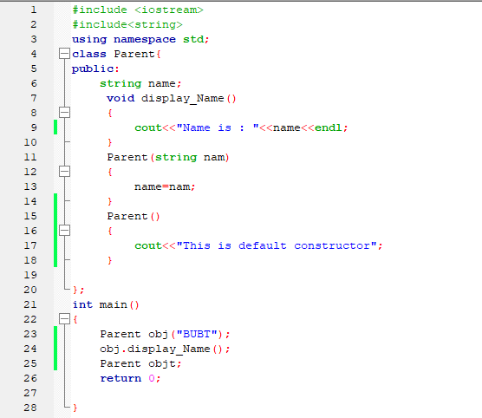
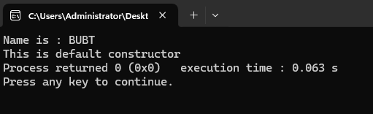
Default Constructors
Default constructor is the constructor which doesn’t take any argument. It has no parameters.

Slide 6
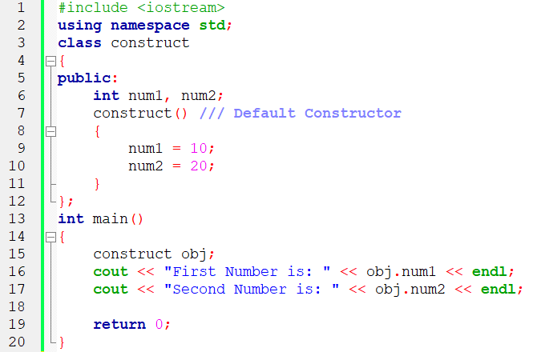
Default Constructors

Slide 7
Parameterized Constructors
It is possible to pass arguments to constructors.
Typically, these arguments help initialize an object when it is created.
To create a parameterized constructor, simply add parameters to it the way you would to any other function.
When you define the constructor’s body, use the parameters to initialize the object.

Slide 8
Parameterized Constructors

Slide 9
Uses of Parameterized Constructors
It is used to initialize the various data elements of different objects with different values when they are created.
It is used to overload constructors.
Can we have more than one constructors in a class? Yes, It is called Constructor Overloading.

Slide 10
Constructor Overloading
In C++, We can have more than one constructor in a class with same name, as long as each has a different list of arguments. This concept is known as Constructor Overloading.
Overloaded constructors essentially have the same name (name of the class) and different number of arguments.
A constructor is called depending upon the number and type of arguments passed.
While creating the object, arguments must be passed to let compiler know, which constructor needs to be called.

Slide 11
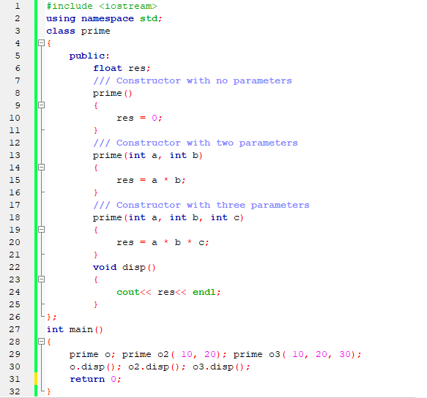
Constructor Overloading

Slide 12
Copy Constructor
A copy constructor is a member function which initializes an object using another object of the same class. A copy constructor has the following general function prototype:
ClassName (const ClassName & objName);

Slide 13
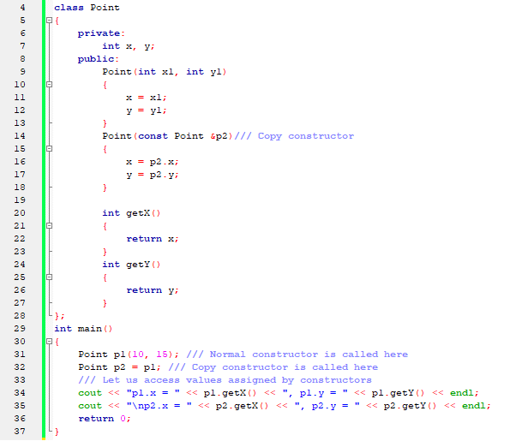
Copy Constructor

Slide 14
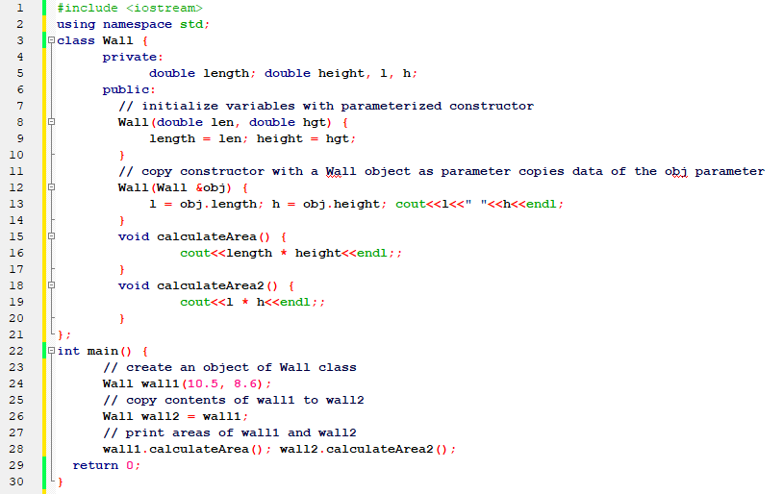
Copy Constructor

Slide 15
When is Copy Constructor Called!!!
When an object of the class is returned by value.
When an object of the class is passed (to a function) by value as an argument.
When an object is constructed based on another object of the same class.
When the compiler generates a temporary object.

Slide 16
Destructors
What is destructor? Destructor is a member function which destructs or deletes an object.
When is destructor called? A destructor function is called automatically when the object goes out of scope:
the function ends
the program ends
a block containing local variables ends
a delete operator is called
How destructors are different from a normal member function? Destructors have same name as the class preceded by a tilde (~). Destructors don’t take any argument and don’t return anything

Slide 17
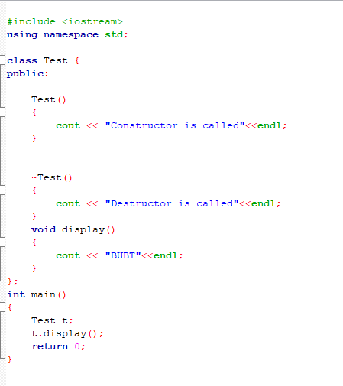
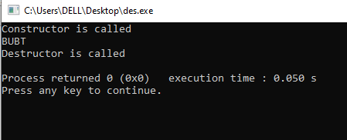
Example of Destructors

Slide 18
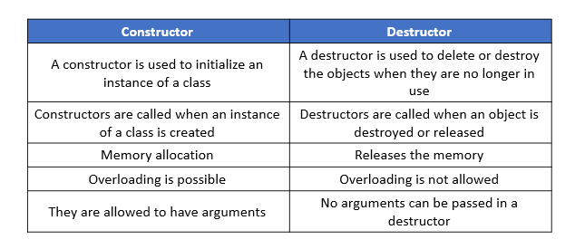
Difference Between Constructors & Destructors

Slide 19
Practice
You are required to design a C++ class named Rectangle that represents a rectangle with a given length and width. The class should include the following:
A parameterized constructor to initialize the length and width when an object is created.
A default constructor that initializes the length and width to 0.
A function area() that returns the area of the rectangle.
A function display() that prints the length, width, and area of the rectangle.

Slide 20
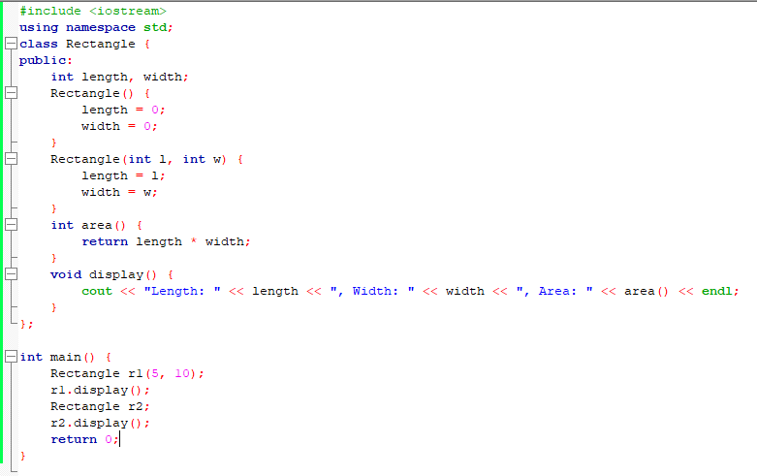

Slide 21
Thank You

